Slide 1
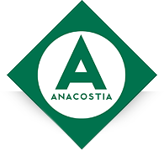
Anacostia Rail Holdings
Pacific Harbor Line: Wind Tower Shipments

Slide 2
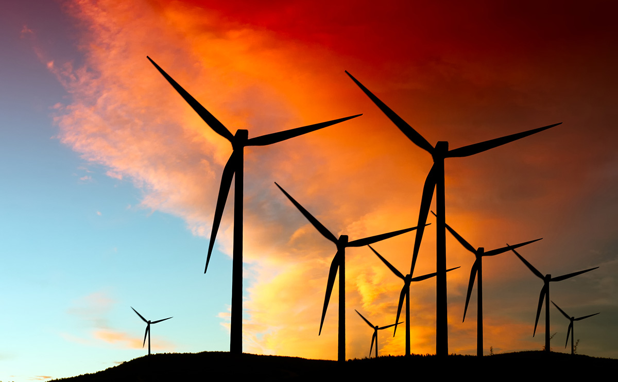
Asia Long Beach KS, IA, TX

Slide 3
Origination and Destination
Wind towers are built in China, South Korea, or Vietnam by various companies (GE, Siemens, etc)
The destinations are various wind farms in the Midwestern U.S., mostly in Kansas and Iowa
Union Pacific RR has the only route from the west coast to the mid-west capable of handling the 15 foot, 3 inch-wide base tower sections
PHL partners with UP & BNSF for loading, interchange, and final delivery

Slide 4
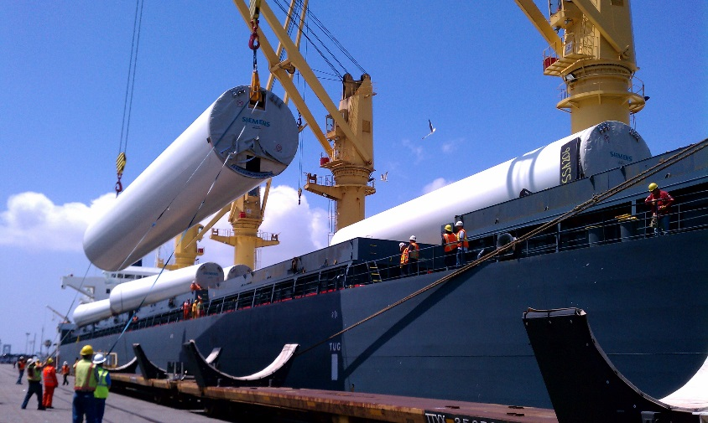
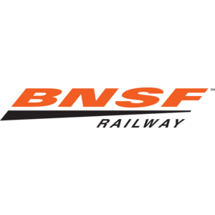
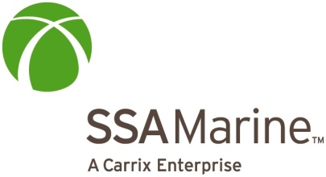
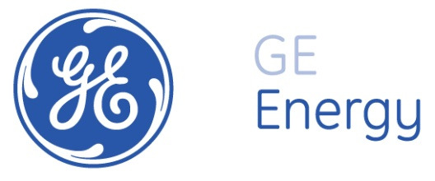
Project Partners

Slide 5
Standard Ship Loading Plan 60 Tower Section/20 Towers

Slide 6
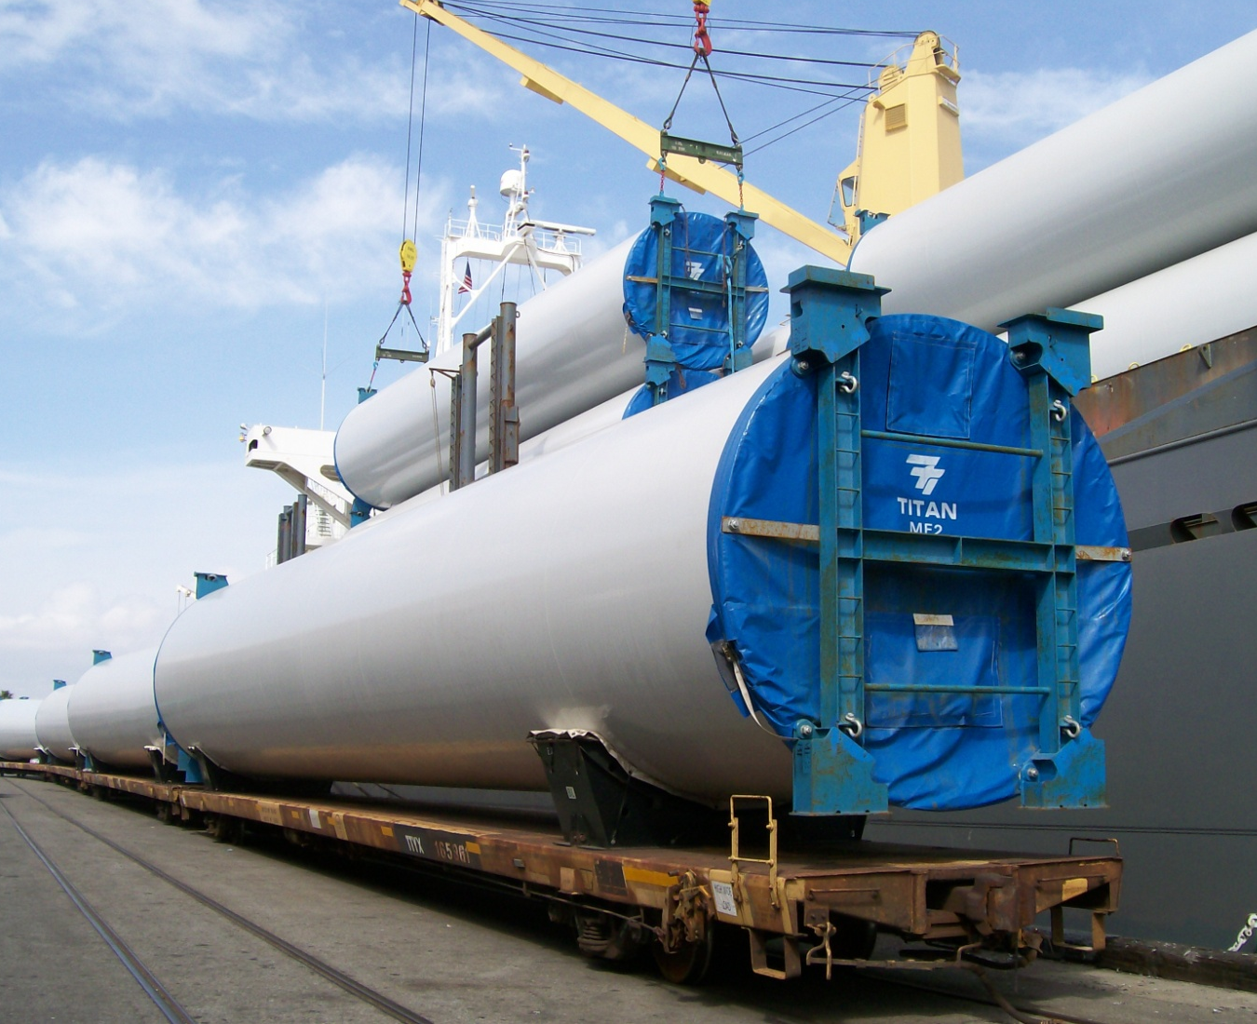
First Direct Discharge From Ship to Rail of Wind Towers (SSA Terminal)

Slide 7
PHL’s Operational Advantages
PHL is in a unique position to move wind towers with service to the two largest ports in the nation
We are known in the industry as experts who provide safe, efficient, professional, and reliable transportation services
Wind energy fits perfectly with PHL’s support of advancements in green technology
PHL provides a premium service that requires us to cooperate with all involved parties: from the unloading to final delivery

Slide 8
Challenges of Moving Wind Towers
Due to the large size of loads, extra care is needed when moving cargo (clearances approved in advance)
Track Congestion – Wind trains compete with intermodal, coal, and potash trains moving in same area
Limited amount of track space to store, inspect, and prep empty cars

Slide 9
Additional Challenges
As this is a specialized service, at times the customer’s desired switch times conflict with neighboring intermodal terminals
Additional employee resources - Extra jobs for every shift (two per day)
Additional Management – A PHL manager must constantly supervise due to complexity of the operation
Competition with the Port of Houston for business due to Class I rates and routes to destination

Slide 10
New 2017 Opportunities
All three manufactures – GE, Siemens, and Vestas – have expressed interest in moving wind towers through the Port of Long Beach between Q3 and Q4 2017
Proposals are out to move wind power components to sites within California

Slide 11
PHL’s Past Wind Tower Moves
Seven wind trains in 2011
Thirteen wind trains in 2012
Eight wind trains in 2013
Ten wind trains in 2014
Four wind trains in 2015
Zero wind trains in 2016

Slide 12
2017 Forecast
UPRR/Siemens is projecting approximately 2 trains for 2017, all destined for KS Q3/Q4
When securing these opportunities, we continuously monitor construction work windows in the Ports, empty train return, strength in the US import market, product specifics, and ILWU labor changes

Slide 13
Conclusion
Moving wind towers can be extremely challenging and resource intensive, however this plays to the strength in innovation and services that Anacostia has always provided.

Slide 14
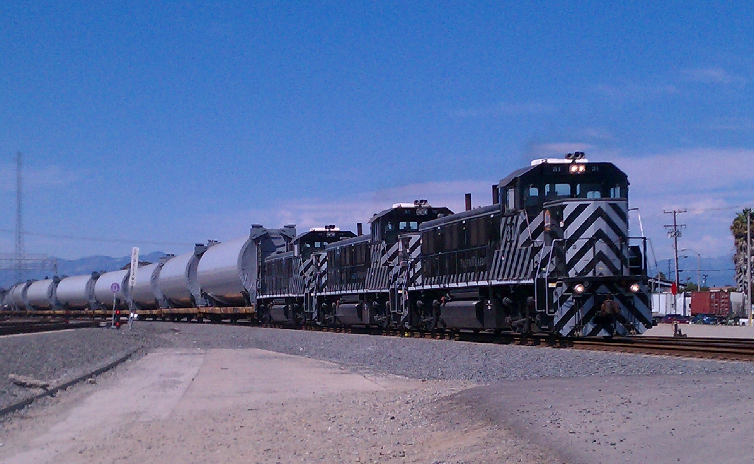
Anacostia is Always a Partner and Advocate for Renewable Energy

